Slide 1
UNIT 5

Slide 2
INTRODUCTION
What is a role of IS professional?
To manage liability for privacy
What they should understand?
understand the current legal environment
stay current with laws and regulations
How they Can?
By educating management and employees
Proper use of Information security
Security Risks
Reduce risks from Electronic and Physical Threats
watch for new and emerging issues

Slide 3
LAWS AND ETHICS IN INFORMATION SECURITY
Laws
Rules that mandate or prohibit certain behavior
Ethics
Define socially acceptable behaviors
Key difference
Laws carry the authority of a governing body
Ethics do not carry the authority of a governing body
Based on cultural mores
Fixed moral attitudes or customs
Some ethics standards are universal

Slide 4
ORGANISATIONAL LIABILITY AND THE NEED FOR COUNSEL
What if an organization does not demand or even encourage strong ethical behaviour from its employees?
What if an organization does not behave ethically?
Even if there is no breach of criminal law, there can still be liability.
Liability is the legal obligation of an entity that extends beyond criminal or contract law;
It includes the legal obligation to make restitution, or to compensate for wrongs committed

Slide 5
ORGANISATIONAL LIABILITY AND THE NEED FOR COUNSEL
The bottom line is that if an employee, acting with or without the authorization of the employer, performs an illegal or unethical act that causes some degree of harm, the employer can be held liable for that action.
An organization increases its liability if it refuses to take measures known as due care.
Due care standards are met
when an organization makes sure that every employee knows what is acceptable or unacceptable behavior,
knows the consequences of illegal or unethical actions.

Slide 6
ORGANISATIONAL LIABILITY AND THE NEED FOR COUNSEL
Due diligence requires
an organization make a valid effort to protect others and continually maintains this level of effort.
Long arm jurisdiction—
the long arm of the law extending across the country or around the world to draw an accused individual into its court systems.

Slide 7
POLICY VERSUS LAW
Policies
Guidelines that describe acceptable and unacceptable employee behaviors.
Functions as organizational laws.
Has penalties, judicial practices, and sanctions.
Difference between policy and law-
Ignorance of policy is acceptable.
Ignorance of law is unacceptable.

Slide 8
POLICY VERSUS LAW
Keys for a policy to be enforceable
Dissemination- Distributed to all individuals who are expected to comply with them.
Review- Readily available for employee reference
Comprehension- Easily understood, with multilingual, visually impaired and low- literacy translations.
Compliance- Acknowledged by employee with consent form.
Uniform enforcement- Enforced for all employees, regardless their status or assignment.
Notes:
Dissemination (distribution)—The organization must be able to demonstrate that the relevant policy has been made readily available for review by the employee. Common dissemination techniques include hard copy and electronic distribution.
● Review (reading)—The organization must be able to demonstrate that it disseminated the document in an intelligible form, including versions for illiterate, non-English reading, and reading-impaired employees. Common techniques include recordings of the policy in English and alternate languages.
● Comprehension (understanding)—The organization must be able to demonstrate that the employee understood the requirements and content of the policy. Common techniques include quizzes and other assessments
Compliance (agreement)—The organization must be able to demonstrate that the employee agreed to comply with the policy through act or affirmation. Common techniques include logon banners, which require a specific action (mouse click or keystroke) to acknowledge agreement, or a signed document clearly indicating the employee has read, understood, and agreed to comply with the policy.
● Uniform enforcement—The organization must be able to demonstrate that the policy has been uniformly enforced, regardless of employee status or assignment.

Slide 9
What is Cyber Crime ?
Definition
Crime
Computer
By whom
Human
Machine
Categories
Narrow sense
Broader sense
Notes:
Cybercrime in a narrow sense (computer crime): Any illegal behaviour directed by means of electronic operations that targets the security of computer systems and the data processed by them.
b. Cybercrime in a broader sense (computer-related crime): Any illegal behavior committed by means of a computer system or network, including such crimes as illegal possession [and] offering or distributing information by means of a computer system or network

Slide 10
Cyber Frauds in India
As per report
1,15000 people
(everyday)
80 per minute
(one per second)
Average financial 10500

Slide 11
Classification of Cyber Crimes
Tampering with computer source documents
Hacking
Publishing of information, which is obscene in electronic form
Accessing protected system
Breach of confidentiality and privacy

Slide 12
Types of Cyber crime
Cyber Stalking{ 63- 23}{62-11}
Cyber squatting
Data Diddling{63-32} {62-32}
Cyber Defamation
Trojan Attack {63-30}{62-22}
Forgery
Web Jacking
Financial crimes
Internet time theft
Virus/worm attack
E-mail spoofing{63- 2}{62-15}
Email bombing
Salami attack {63-46}{62-55}

Slide 13
CYBER CRIMES FOUND IN INDIA
Sale of illegal articles
Online gambling
Intellectual Property crimes
Email spoofing
Unauthorized access to computer systems or networks
Email bombing
Salami attacks
Trojan Attack
. Cyber stalking
Notes:
18, 43

Slide 14
WHO COMMITS CYBER CRIME?
Insider
Hacker
Virus writer
Foreign intelligence
Terrorists

Slide 15
CYBER CRIME ON THE RISE
As per the cyber crime data maintained by the National Crime Records Bureau (NCRB)
INFORMATION TECHNOLOGY ACT,2000 | 2007 | 2008 | 2009 | 2010
CASES FILED | 217 | 288 | 420 | 966
ARRESTED | 154 | 178 | 288 | 799
C YBER CRIME, INDIAN PENEL CODE (IPC) | 2007 | 2008 | 2009 | 2010
CASES FILED | 328 | 176 | 276 | 356
ARRESTED | 429 | 195 | 263 | 294

Slide 16
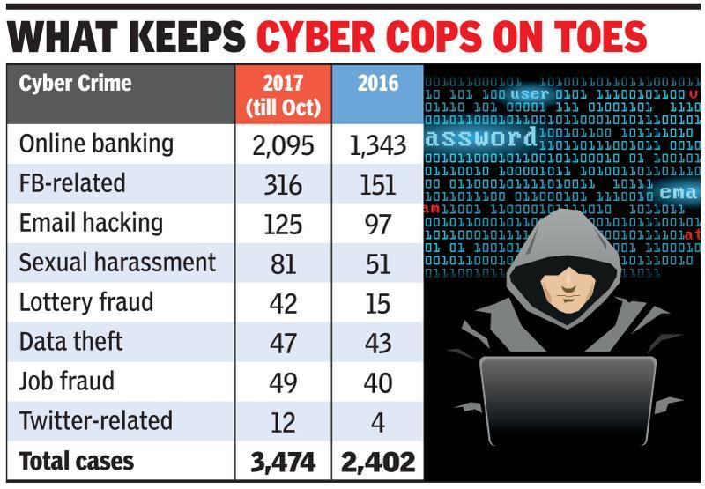
Cyber Crime on the rise

Slide 17
CYBER LAW OF INDIA
In India, cyber laws are contained in the Information Technology Act, 2000 ("IT Act") which came into force on October 17, 2000.
The main purpose of the Act is to provide legal recognition to electronic commerce and to facilitate filing of electronic records with the Government.
The following Act, Rules and Regulations are covered under cyber laws:
1. Information Technology Act, 2000
2. Information Technology (Certifying Authorities) Rules, 2000
3. Information Technology (Security Procedure) Rules, 2004
4. Information Technology (Certifying Authority) Regulations, 2001

Slide 18
The salient features of The IT Act, 2000 are as follows −
Digital signature has been replaced with electronic signature to make it a more technology neutral act.
It elaborates on offenses, penalties, and breaches.
It outlines the Justice Dispensation Systems for cyber-crimes.
The Information Technology Act defines in a new section that cyber café is any facility from where the access to the internet is offered by any person in the ordinary course of business to the members of the public.

Slide 19
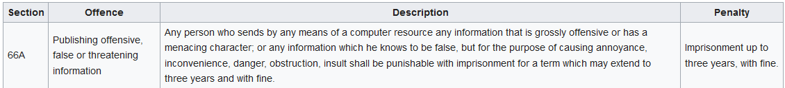
INFORMATION TECHNOLOGY ACTS
United Nations Model Law on Electronic Commerce 1996 (UNCITRAL Model)
signed by President K. R. Narayanan on 9 May 2000. finalised by Pramod Mahajan
Notes:
General Assembly of United Nations by a resolution dated 30 January 1997

Slide 20
Continued
Legal Recognition of Electronic Documents
Legal Recognition of Digital Signatures
Offenses and Contraventions
Justice Dispensation Systems for cyber crimes.

Slide 21
Amendment Act 2008
Focussing on data privacy
Focussing on Information Security
Defining cyber café
Making digital signature technology neutral
Defining reasonable security practices to be followed by corporate
Redefining the role of intermediaries
Recognising the role of Indian Computer Emergency Response Team
Inclusion of some additional cyber crimes like cyber terrorism
authorizing an Inspector to investigate cyber offences (as against the DSP earlier)

Slide 22
NEED FOR CYBER LAW IN INDIA
First the coming of the Internet led to the emergence of numerous ticklish legal issues and problems which necessitated the enactment of Cyber laws.
Secondly, the existing laws of India, could not be interpreted in the light of the emerging cyberspace, to include all aspects relating to different activities in cyberspace.
Thirdly, none of the existing laws gave any legal validity or sanction to the activities in Cyberspace.
Fourthly, Internet requires an enabling and supportive legal infrastructure in tune with the times
Notes:
Thirdly, none of the existing laws gave any legal validity or sanction to the activities in Cyberspace. For example, the Net is used by a large majority of users for email. Yet till today, email is not "legal" in our country. There is no law in the country, which gives legal validity, and sanction to email. Courts and judiciary in our country have been reluctant to grant judicial recognition to the legality of email in the absence of any specific law having been enacted by the Parliament. As such the need has arisen for Cyber law.

Slide 23
NEED FOR CYBER LAW IN INDIA
Almost all transactions in shares are in demat form.
Almost all companies extensively depend upon their computer networks and keep their valuable data in electronic form.
Government forms including income tax returns, company law forms etc. are now filled in electronic form.
Consumers are increasingly using credit cards for shopping.
Most people are using email, cell phones and SMS messages for communication.

Slide 24
Even in "non-cyber crime" cases, important evidence is found in computers / cell phones e.g. in cases of divorce, murder, kidnapping, tax evasion, organized crime, terrorist operations, counterfeit currency etc.
Cyber crime cases such as online banking frauds, online share trading fraud, source code theft, credit card fraud, tax evasion, virus attacks, cyber sabotage, phishing attacks, email hijacking, denial of service, hacking, pornography etc are becoming common.
Digital signatures and e-contracts are fast replacing conventional methods of transacting business

Slide 25
CASE
In November 2012, IPS officer Amitabh Thakur and his wife social activist Nutan Thakur, filed a petition in the Lucknow bench of the Allahabad High Court claiming that the Section 66A violated the freedom of speech guaranteed in the Article 19(1)(a) of the Constitution of India. They said that the section was vague and frequently misused.^{[24]}
Also in November 2012, a Delhi-based law student, Shreya Singhal, filed a Public Interest Litigation (PIL) in the Supreme Court of India. She argued that the Section 66A was vaguely phrased, as result it violated Article 14, 19 (1)(a) and Article 21 of the Constitution. The PIL was accepted on 29 November 2012.^{[25][26]} A similar petition was also filed by the founder of MouthShut.com, Faisal Farooqui,^{[27]} and NGO Common Cause represented by Prashant Bhushan^{[28]} In August 2014, the Supreme Court asked the central government to respond to petitions filed by Mouthshut.com and later petition filed by the Internet and Mobile Association of India (IAMAI) which claimed that the IT Act gave the government power to arbitrarily remove user-generated content.

